Slide 1
AIML Assignment 1
By Ashley Bai (P2237871)
(AI)

Slide 2
Table of contents
01
02
Classification: credit_dataset.csv
Regression: housing_dataset.csv

Slide 3
01
Classification
credit_dataset.csv

Slide 4
Background
This is a dataset collected from a bank.
This dataset contains 1600 data points with 13 columns.
The aim of this dataset is from the perspective of risk management, the bank wants to build a classification model to predict which customer will have default payment in the next month.
Dataset includes:
Customer ID: Unique customer identifier ranging from 1 to 1600
Credit Limit: The credit limit for the customer
Gender: Customer gender
Education: Customer education level
Marriage Status: Customer marital status
Age: Rotational Customer age
Bill_Amount1: Customer credit card bill amount 1 month ago
Bill_Amount2: Customer credit card bill amount 2 month ago
Bill_Amount3: Customer credit card bill amount 3 month ago
Pay_Amount1: The amount customer paid 1 month ago
Pay_Amount2: The amount customer paid 2 month ago
Pay_Amount3: The amount customer paid 3 month ago
Default payment next month: Whether customer will default next month,
1 means default (customer will not pay the bill), 0 means non default (customer will pay the bill)

Slide 5
01
EDA
credit_dataset.csv

Slide 6
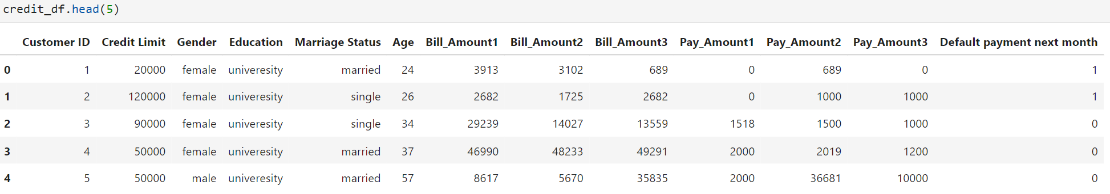
Explanatory Data Analysis (EDA)
This is the general overview of the original credit dataframe.
It is evident that University is spelled wrongly.
The dataset contains categorical and numerical variables.

Slide 7
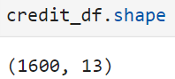
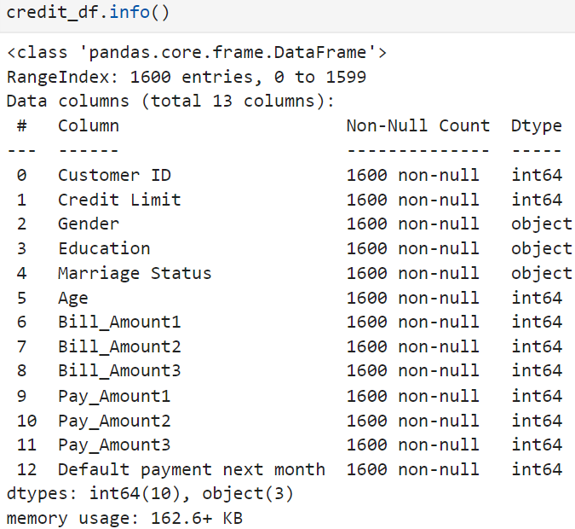
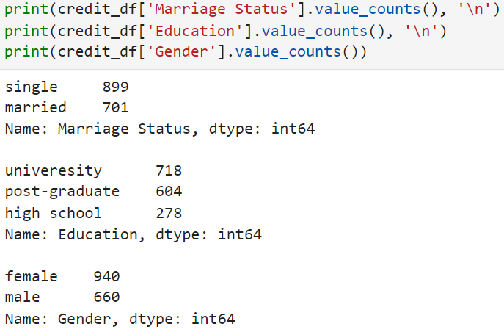
Explanatory Data Analysis (EDA)
There are 1600 rows and 13 columns in df.
Categorical variables: Gender, Education, Marriage Status.
There are no null values in the df.

Slide 8
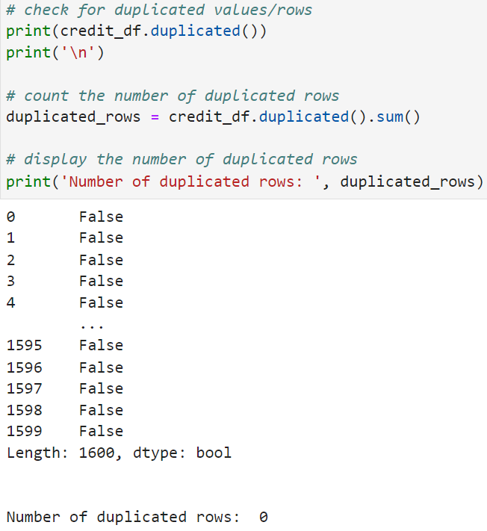
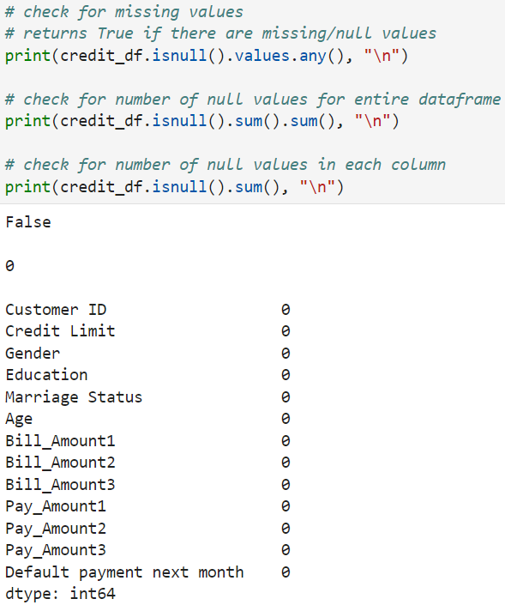
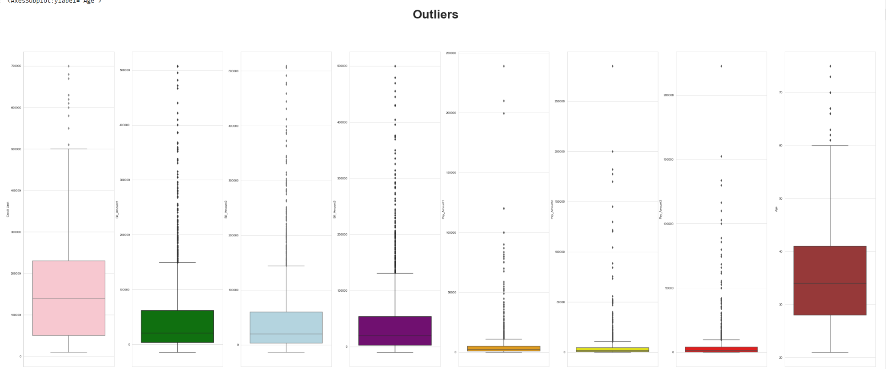
Explanatory Data Analysis (EDA)
There are no duplicates in the df.
There are no missing values in the df.
There is presence of outliers in df.

Slide 9
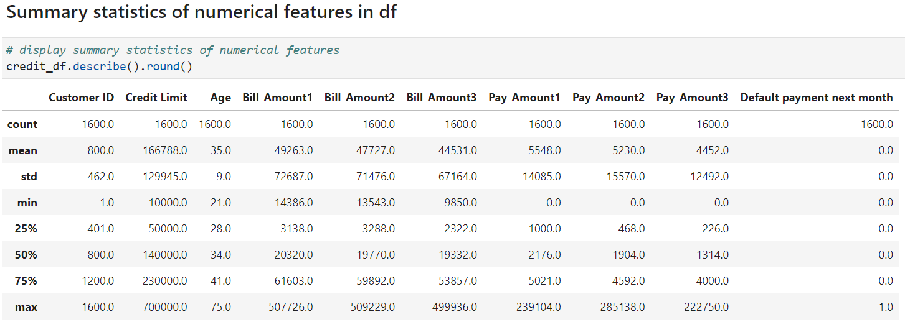
Explanatory Data Analysis (EDA)
There are 1600 distinct credit card clients.
The mean value for the amount of credit limit for customer is $166,788.
Std for Credit Limit is large (min:10k - max:700k).
Average age of customers is 35 years old.
Negative Bill Amounts show that there are customers who have outstanding balance. (exceeded their credit limit)

Slide 10
01
Data Pre-Processing
credit_dataset.csv

Slide 11
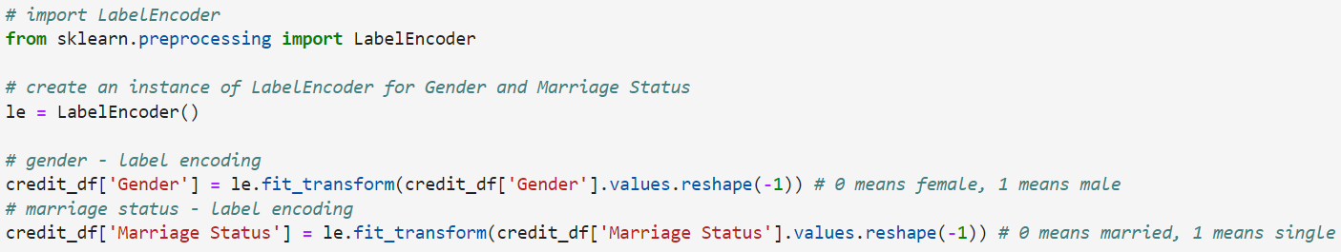
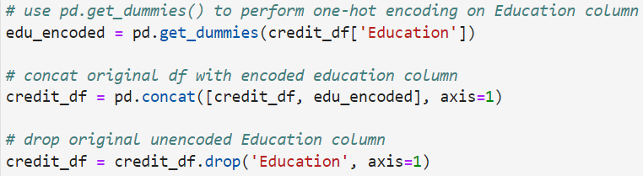
Data Pre-Processing
(1) Handled categorical variables
Performed Label Encoding with Sklearn on Gender, Marriage Status.
Performed One-Hot Encoding with Pandas on Education.
(2) Renamed columns in dataframe

Slide 12
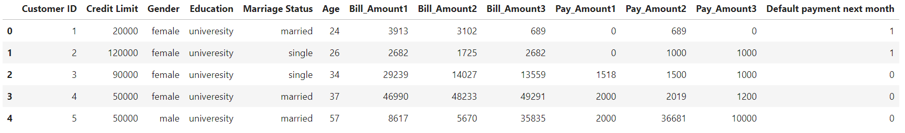
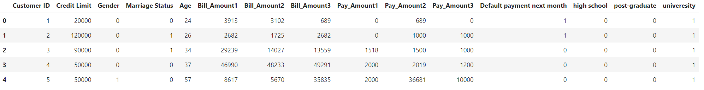
Data Pre-Processing
Before:
After:
The columns in dataframe are now all numerical, and suitable to be used for machine-learning models.

Slide 13
01
Feature Engineering
credit_dataset.csv

Slide 14
Feature Engineering
(1) PayAmt_Delay1,2,3
Calculated by Bill_Amount - Pay Amount
To show how punctual and capable customers are in paying their bills, understand customer’s payment behaviour, whether or not they are able to pay their credit card bills in one shot fully.
(2) Utilized_Amount1,2,3
Calculated by Bill Amount / Credit Limit
This will tell us how much of their available credit does customer utilize based on months.
All these features will affect prediction of default payment next month, as it enhances information as to the spending and paying capability of customer.
Hence giving models more insights to credit dataset, enhancing predictive power of models.

Slide 15
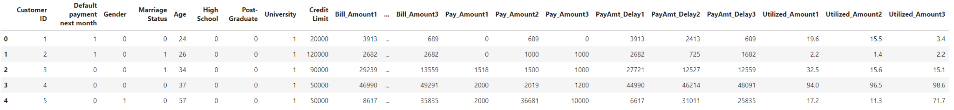
Feature Engineering
This is how the final dataset looks like.
Dataset only contains numerical variables.
From 13 columns, there are now 21.

Slide 16
01
Data Visualization
credit_dataset.csv

Slide 17
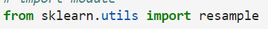
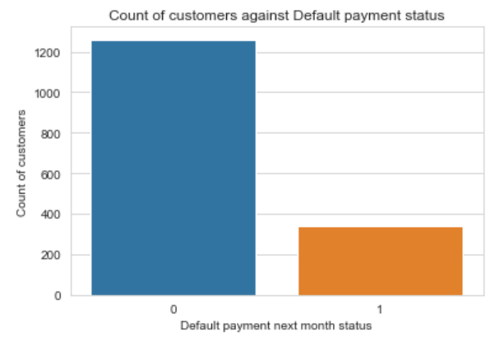
Data Visualization
Explore the target variable: Default payment next month
Countplot showed presence of class imbalance which may affect model predictive power.
Since ‘1’ (area of interest: has default payment) is the minority, I used random oversampling technique by Sklearn to balance the imbalance class distribution.
Before:
After:

Slide 18
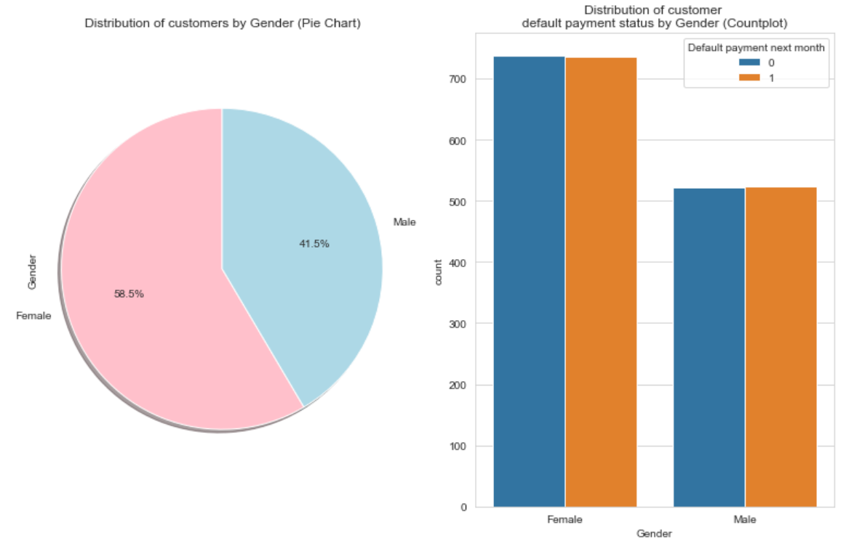
Data Visualization
Relationship between Gender and Default Payment Status
Pie chart shows that there is a greater proportion of female to male customers.
As such, it is predictable that the number of defaulters who are female will be much higher than that of male.
The ratio of defaulters to non-defaulters of both female and male are evidently very similar.

Slide 19
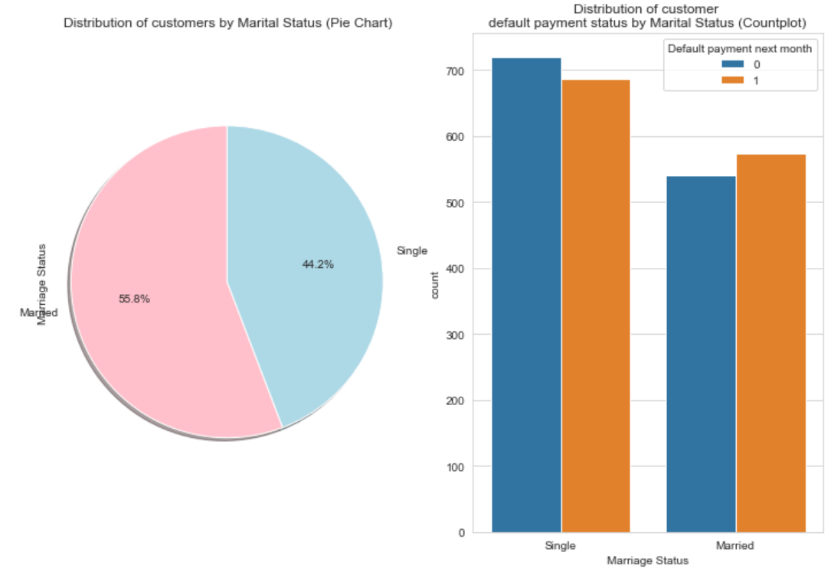
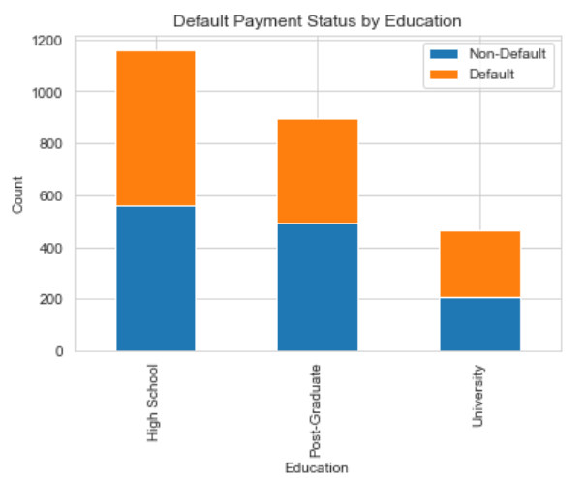
Data Visualization
Relationship between Marriage Status and Default Payment Status
Pie chart shows that there is a greater proportion of married to single customers.
There is a greater proportion of defaulters who are single than married.
Relationship between Education and Default Payment Status
Bar graphs show that the proportion of customers who have a high school background is the greatest.
The number of defaulters to non-defaulters for each education type is similar.

Slide 20
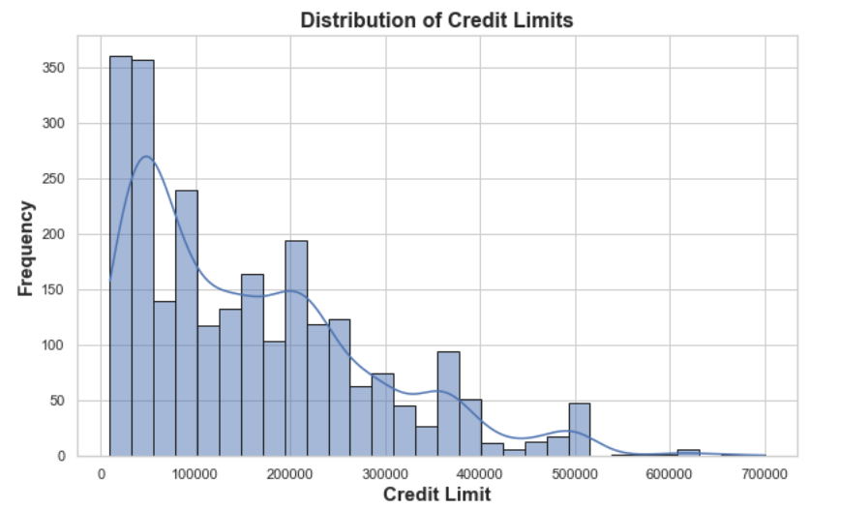
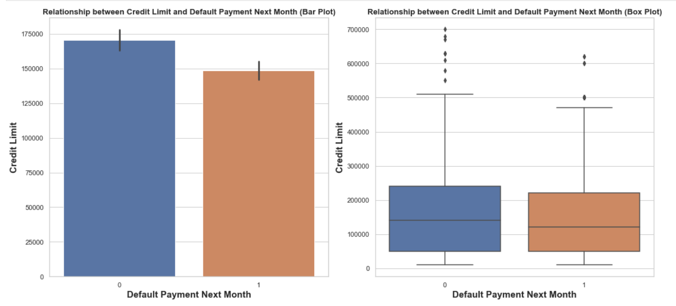
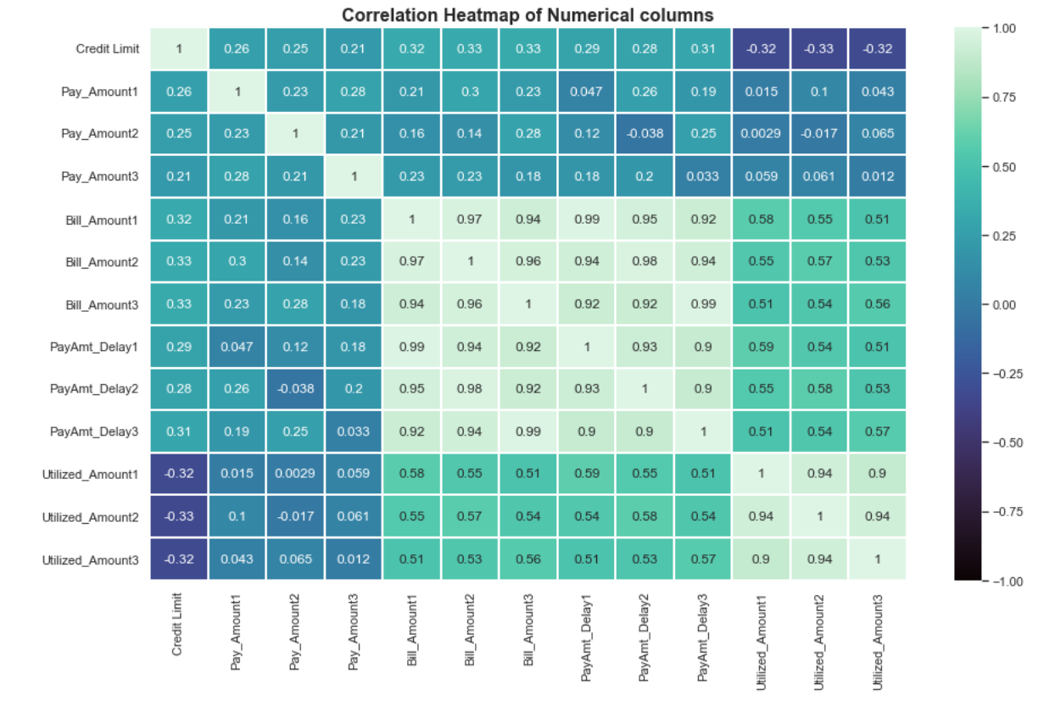
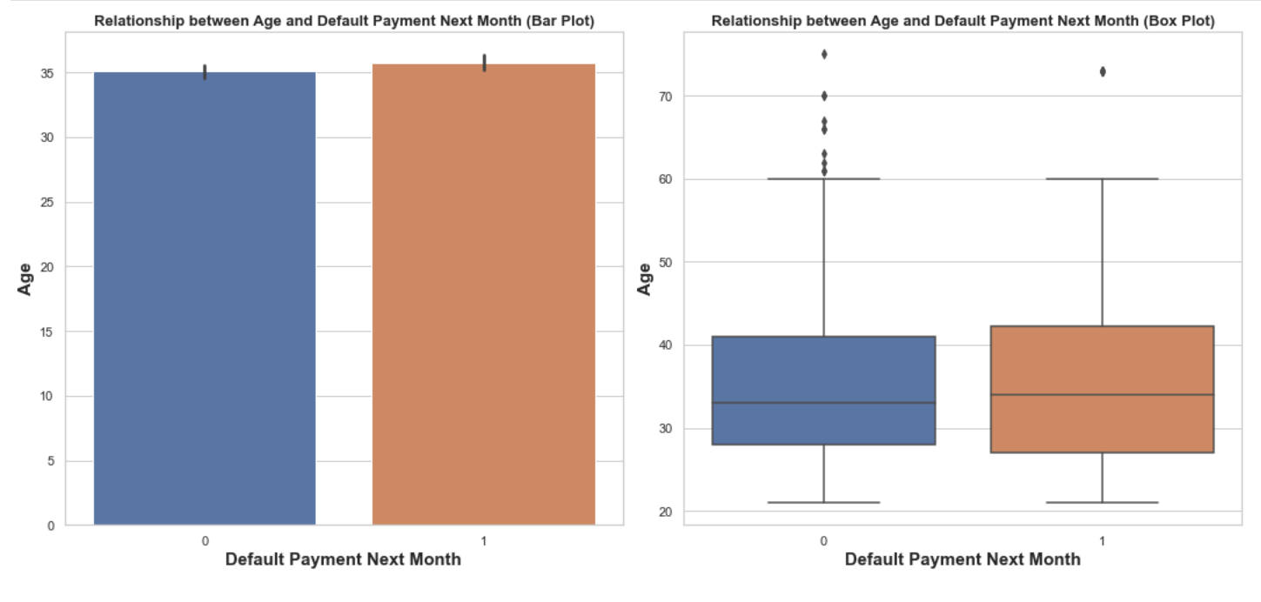
Data Visualization

Slide 21
01
Building
Classification Models
credit_dataset.csv

Slide 22
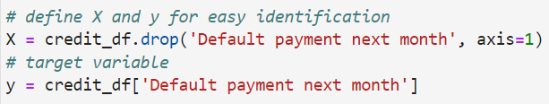
Classification Models
Models Built:
K-Nearest Neighbor (KNN)
Logistic Regression
Decision Tree Classifier
Gaussian Naive Bayes
Support Vector Classifier (SVC)
Random Forest Classifier

Slide 23
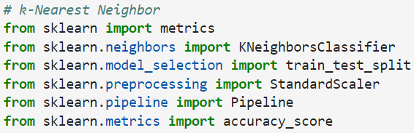
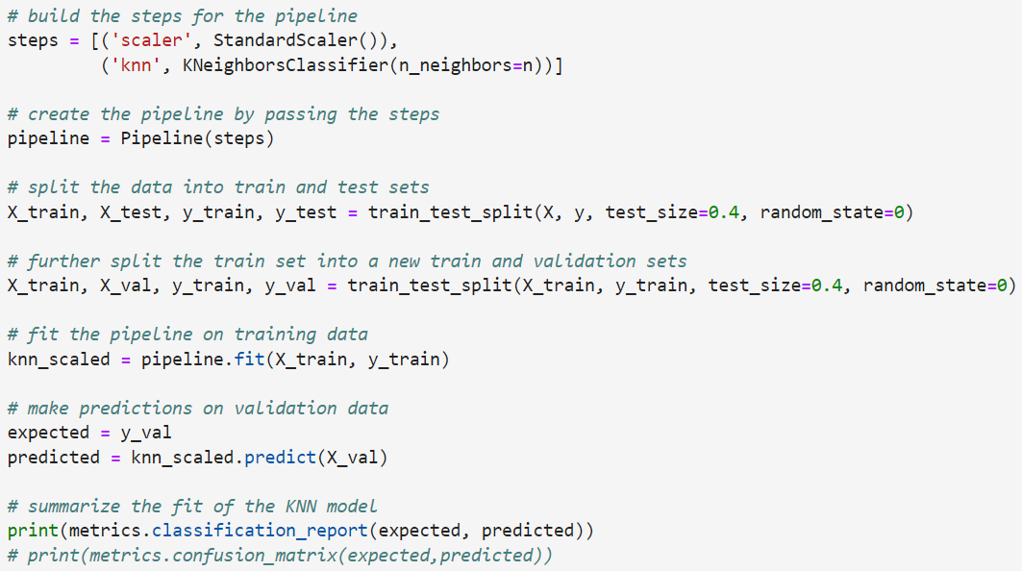
K-Nearest Neighbor (KNN)
Built this model with Sklearn.
Imported all the necessary modules.
Did feature-scaling.
Created a pipeline.
Checked to see which hyperparameter will yield best results.

Slide 24
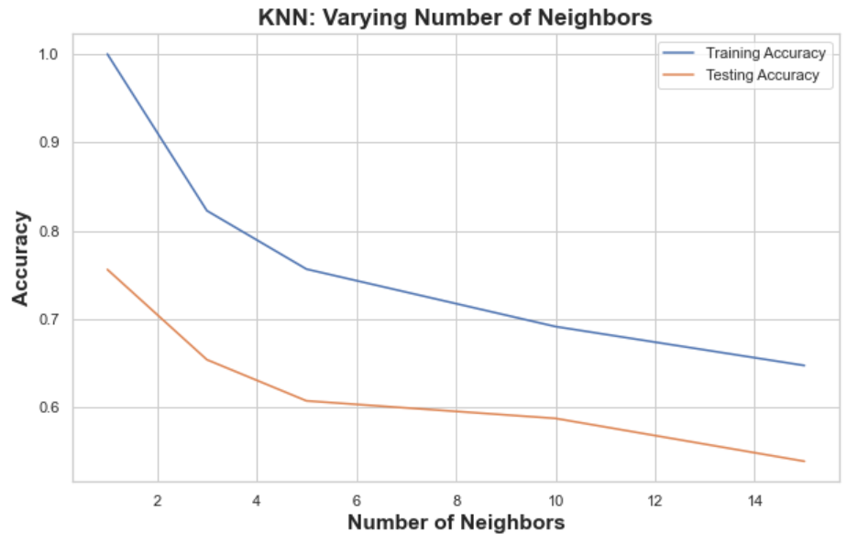
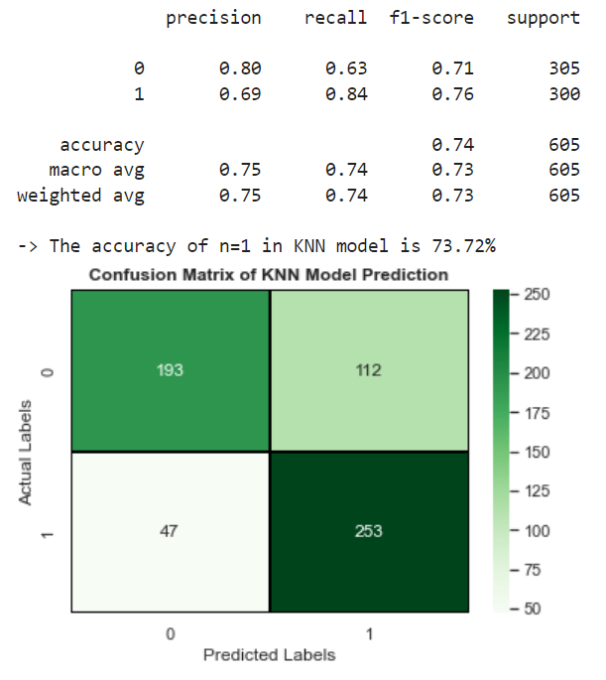
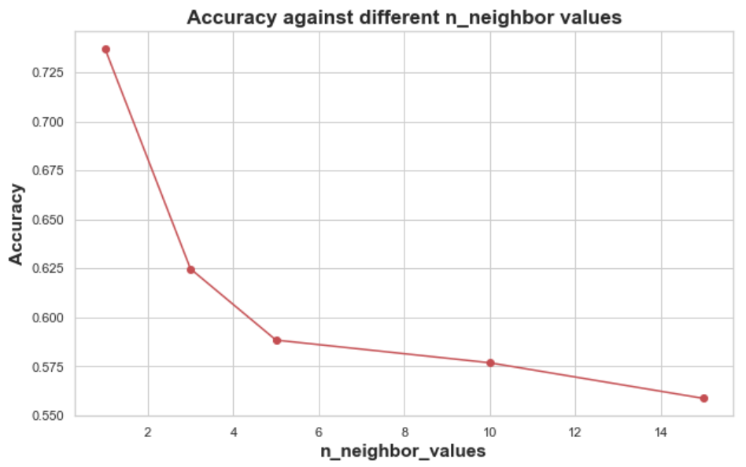
K-Nearest Neighbor (KNN)
From the 2 graphs, it is evident that n=1 yields the highest accuracy value.
The above shows the confusion matrix and classification report, evaluating the performance of KNN model.

Slide 25
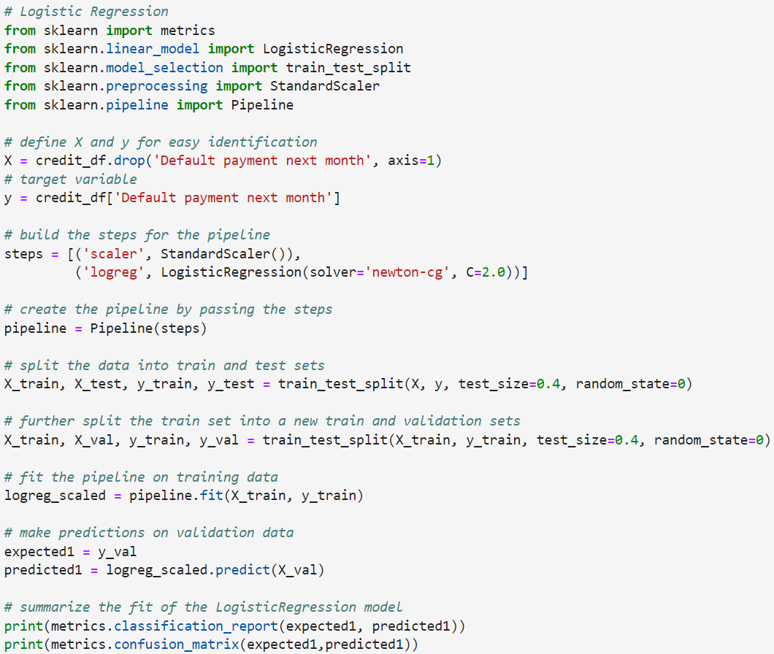
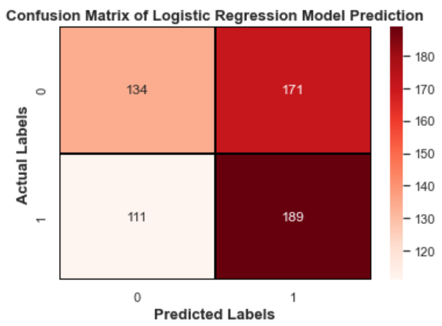
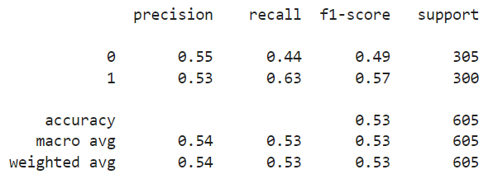
Logistic Regression
Built this model with Sklearn.
Imported all the necessary modules.
Did feature-scaling.
Created a pipeline.

Slide 26
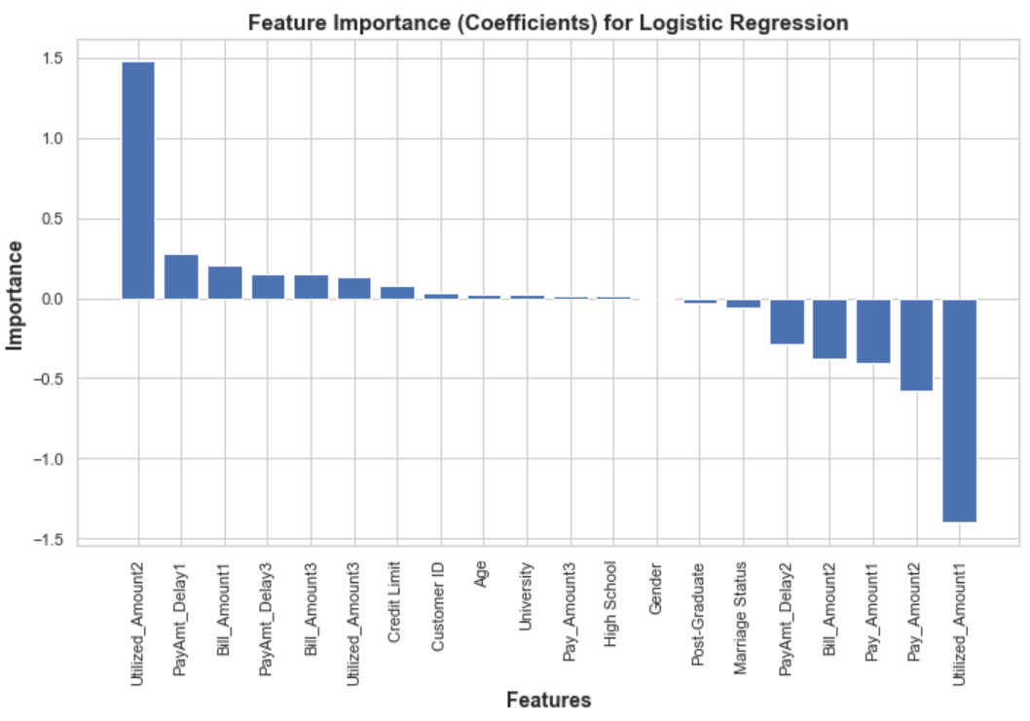
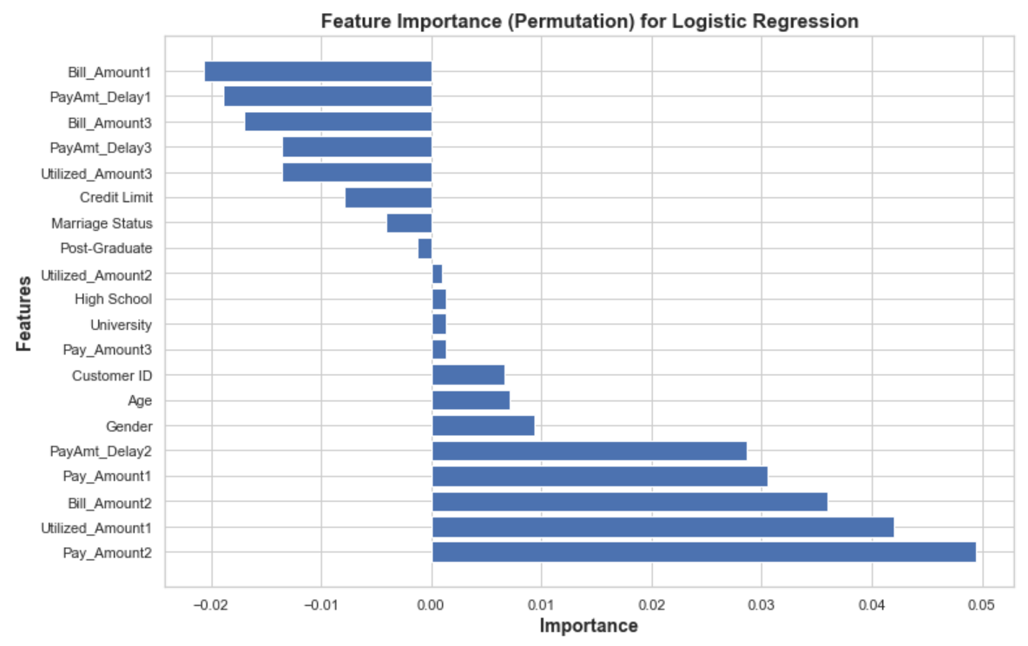
Logistic Regression
Via Permutation:
Pay_Amount2 (positive) and Bill_Amount1 (negative) has the greatest impact on model prediction.
Pay Amounts, Bill Amounts and Utilized Amounts have high impact on model.
Via coefficients:
Utilized_Amount2 (positive) and Utilized_Amount1 (negative) has the greatest impact on model prediction.
Surprisingly, Credit Limit had little impact on model.

Slide 27
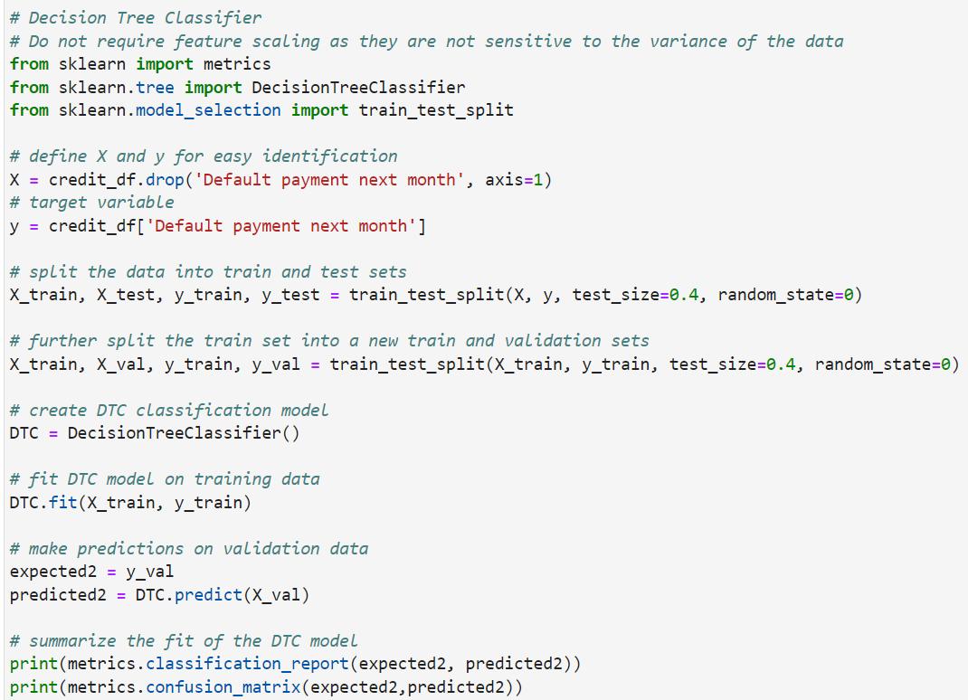
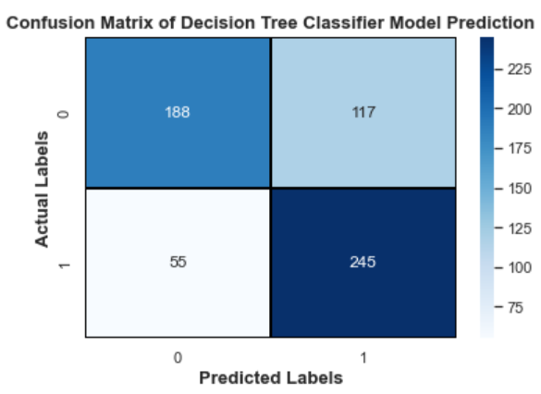
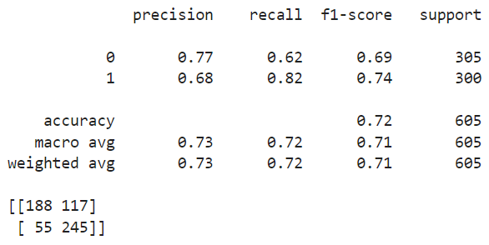
Decision Tree Classifier
Built this model with Sklearn.
Imported all the necessary modules.
Did not require feature scaling as the model is not sensitive to variance of data.

Slide 28
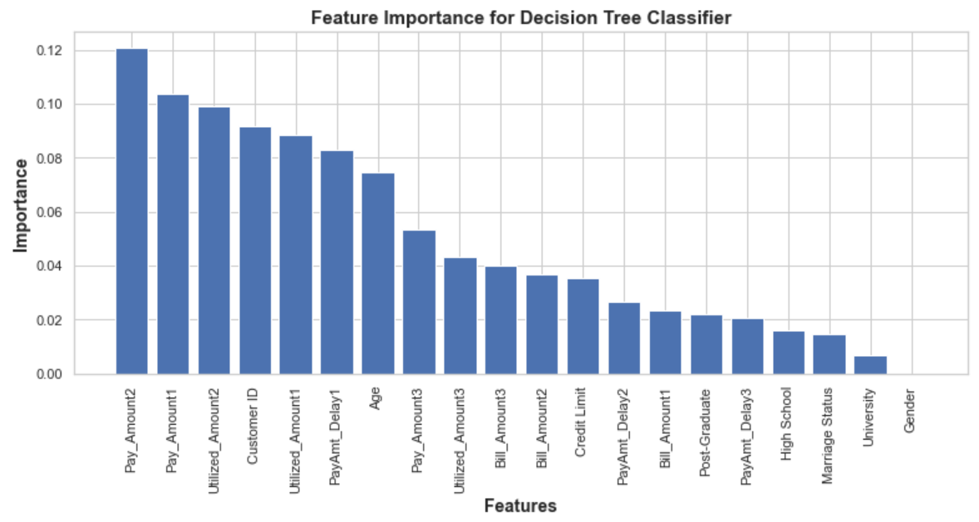
Decision Tree Classifier
.feature_importances_ by Sklearn:
Pay Amounts, Utilized Amounts, Bill Amounts have high impact on model performance.

Slide 29
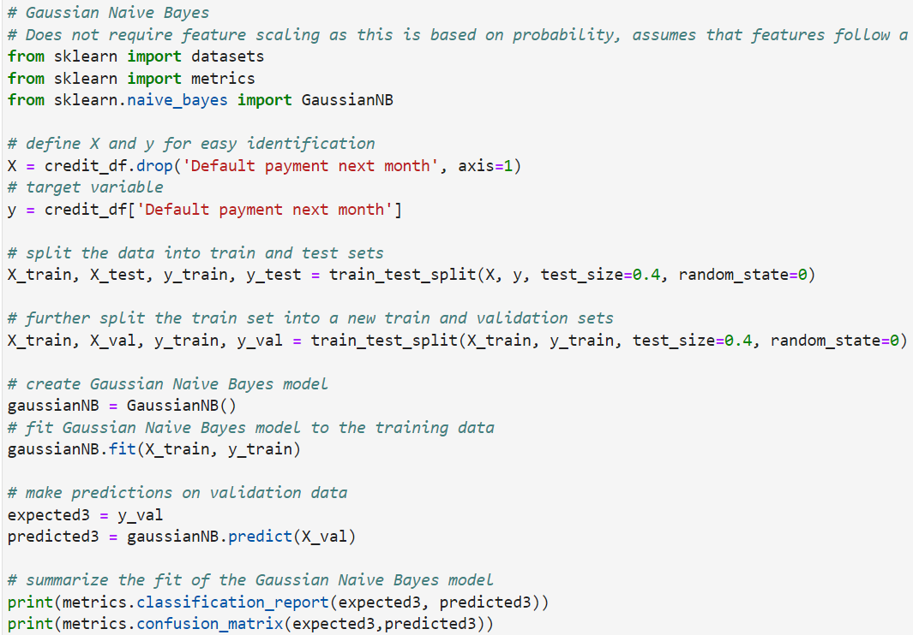
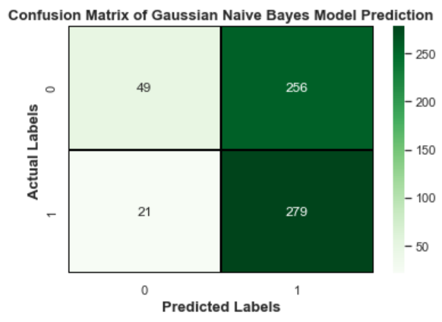
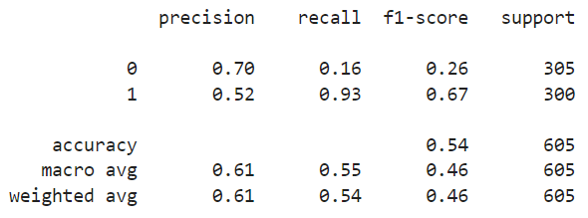
Gaussian Naive Bayes
Built this model with Sklearn.
Imported all the necessary modules.
Did not require feature scaling as the model is based on probability, assumes that features follow a Gaussian (normal) distribution.

Slide 30
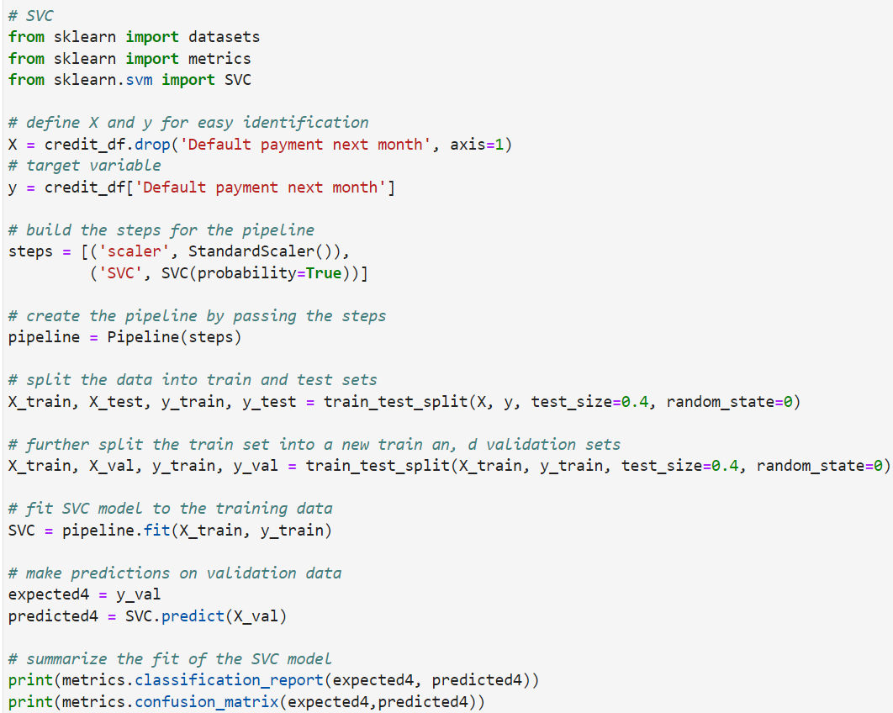
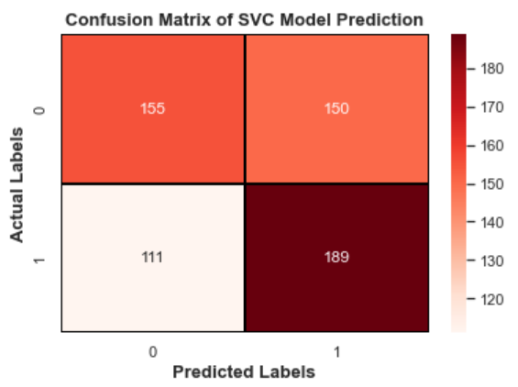
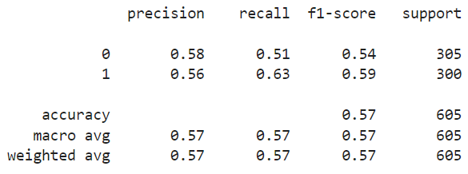
Support Vector Classifier (SVC)
Built this model with Sklearn.
Imported all the necessary modules.
Did feature scaling.
Created a pipeline.

Slide 31
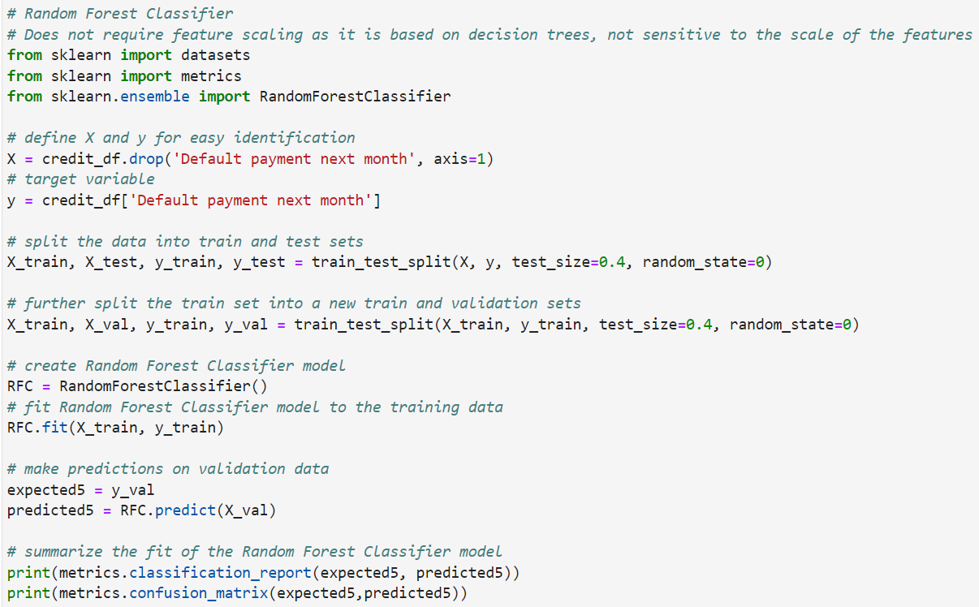
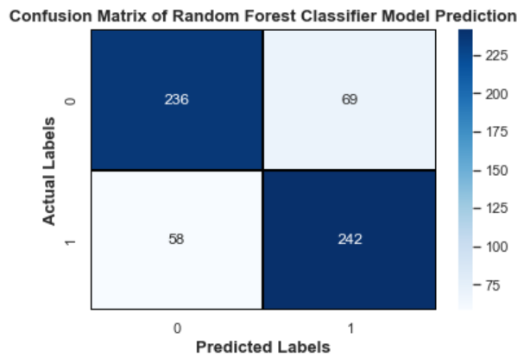
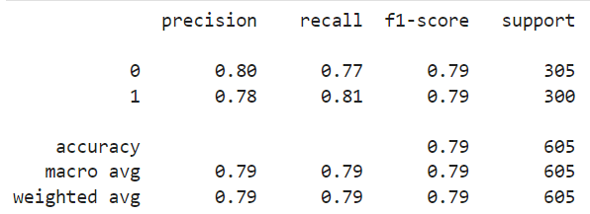
Random Forest Classifier
Built this model with Sklearn.
Imported all the necessary modules.
Did not require feature scaling as model is based on decision trees, and is not sensitive to scale of features.

Slide 32
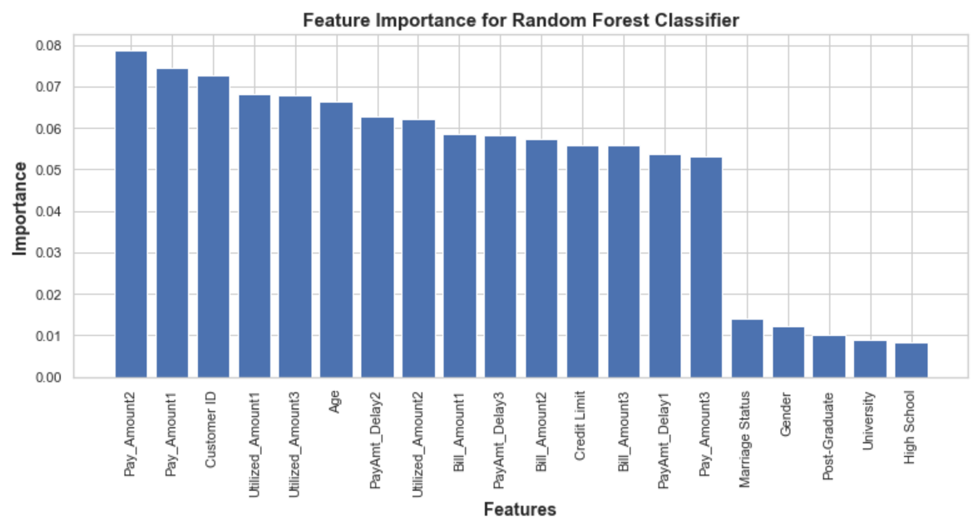
Random Forest Classifier
.feature_importances_ by Sklearn:
Pay Amounts, Utilized Amounts, Bill Amounts have high impact on model performance.

Slide 33
01
Choosing the One
credit_dataset.csv

Slide 34
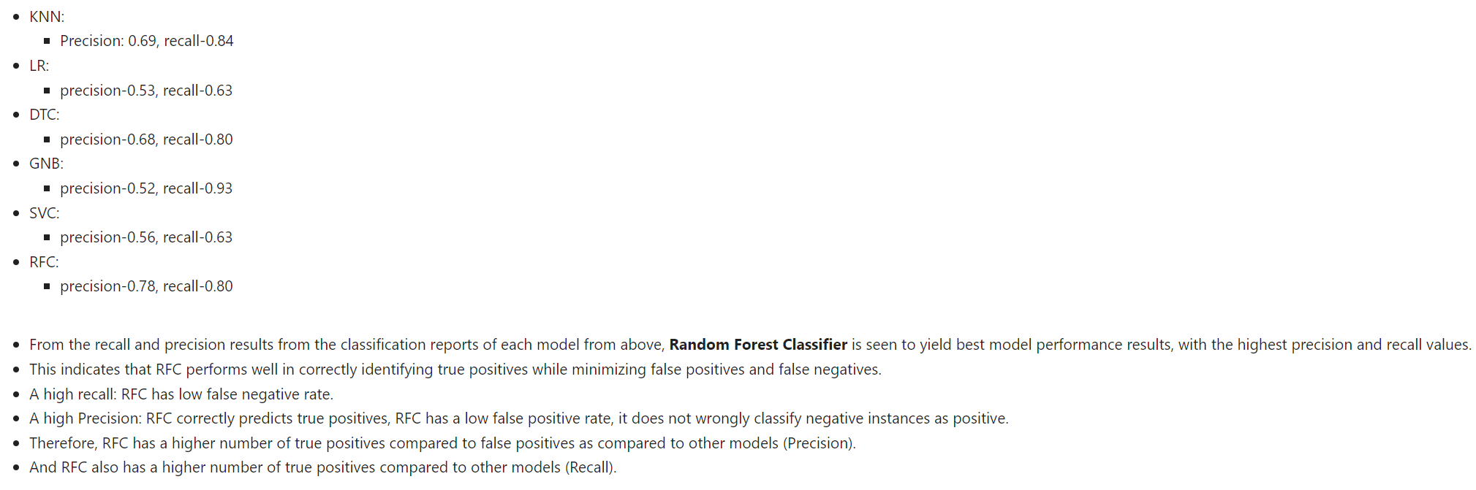
Comparing Confusion Matrix and Classification Reports

Slide 35
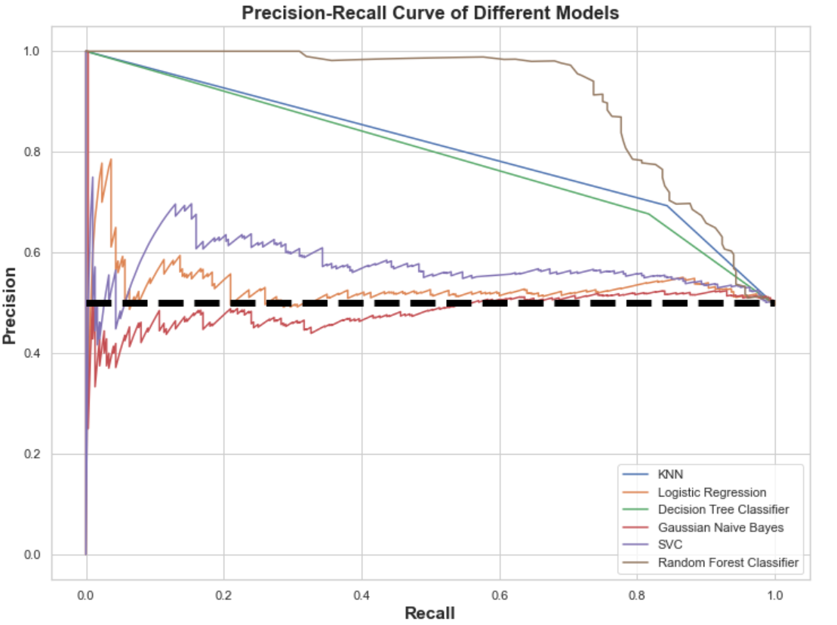
2. Precision-Recall Curves
From the graph,
It is seen that RFC has a higher precision-recall trade-off as compared to the other models.
RFC is very close to the upper-right corner of the figure, indicating that it has high precision and recall values.
RFC has the highest precision and recall values as compared to the other models.
Black-line (baseline): random classifier, precision and recall is balanced.
KNN and decision tree classifier is also not too far behind RFC in terms of high precision and recall values.
Since Gaussian Naive Bayes, SVC, Logistic Regression are all near the random baseline, it indicates that these models do not have such prominently high recall and precision values and hence should not be considered as chosen models.
RFC seems to be the best model here, as it dominates and is consistently above the curves of other models.

Slide 36
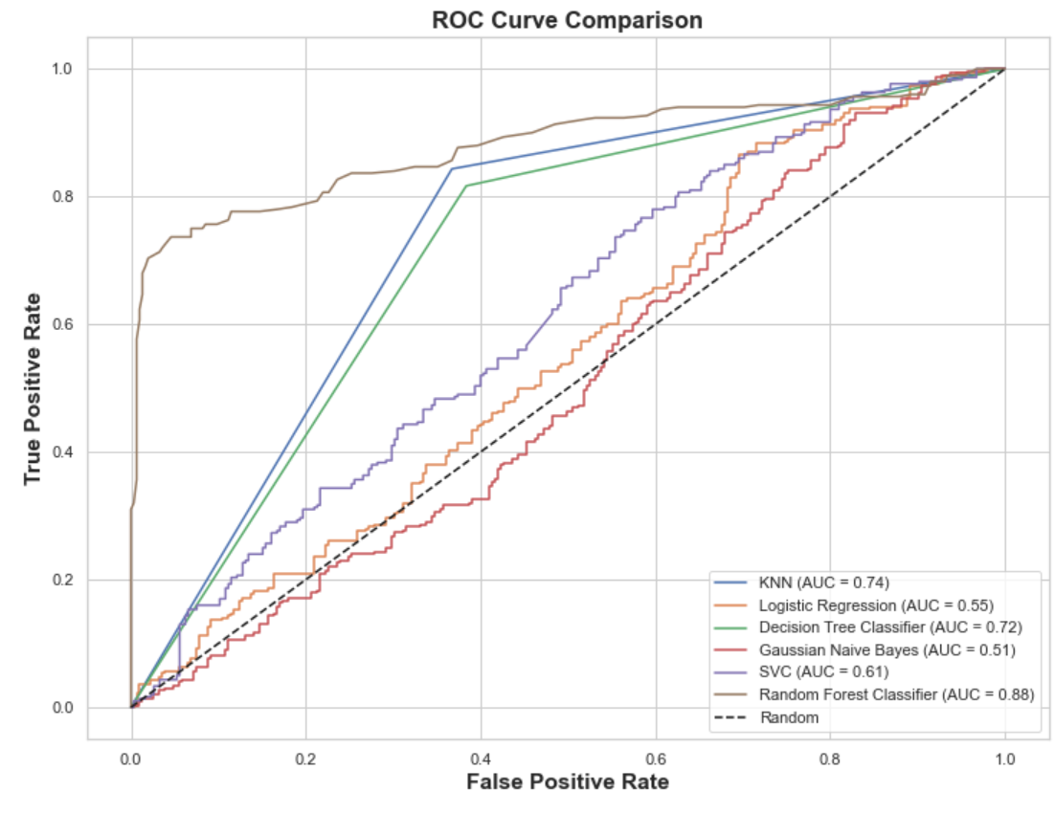
3. ROC Curves and AUC
Interpretting the ROC Curve
A ROC Curve is constructed by plotting the true positive rate (TPR) against false positive rate (FPR).
Ideal: 1.0 for TPR
Baseline: a random classifier that gives (TPR = FPR)
The closer the curve comes nearer to diagonal baseline, the less accurate model is.
From the graph above, Random Forest Classifier model has the best rates as it has the highest true positive rate, and lowest false positive rate (close to zero).
Area under curve (AUC)
AUC = 1.0: perfect classifier that has a TPR of 1, and FPR of 0.
AUC = 0.5: useless (random guessing)
0.5<AUC<1.0: higher the AUC, better the model.
From graph above, Random Forest Classifier has best AUC value.
Therefore, Random Forest Classifier seems to be the best classification model used to predict which customer will have default payment next month.

Slide 37
3. ROC Curves and AUC
Interpretting the ROC Curve
A ROC Curve is constructed by plotting the true positive rate (TPR) against false positive rate (FPR).
Ideal: 1.0 for TPR
Baseline: a random classifier that gives (TPR = FPR)
The closer the curve comes nearer to diagonal baseline, the less accurate model is.
From the graph above, Random Forest Classifier model has the best rates as it has the highest true positive rate, and lowest false positive rate (close to zero).
Area under curve (AUC)
AUC = 1.0: perfect classifier that has a TPR of 1, and FPR of 0.
AUC = 0.5: useless (random guessing)
0.5<AUC<1.0: higher the AUC, better the model.
From graph above, Random Forest Classifier has best AUC value.
Therefore, Random Forest Classifier seems to be the best classification model used to predict which customer will have default payment next month.

Slide 38
01
Model Improvement and Hyperparameter Tuning
credit_dataset.csv

Slide 39


GridSearchCV
Performed GridSearchCV on best model Random Forest Classifier.
Found the best combination of hyperparameter to yield best results.

Slide 40


Using the best model on testing set

Slide 41


Comparing best model to dummy model

